Slide 1
Autoencoder
Topics
Introduction to autoencoder
Examples
Idea for feature set
With MLP idea
Exercise

Slide 2
An autoencoder is a neural network that tries to reconstruct its input.
So if you feed the autoencoder the vector (1,0,0,1,0) the autoencoder will try to output (1,0,0,1,0). Of course I will have to explain why this is useful and how this works.
The trick is the hidden layer, say you have inputs in 5 dimensions as in our example if we use 2 neurons in the hidden layer then our autoencoder will receive 5 features, and "encode" them in 2 features in a way such as it can re-construct the same 5 dim input.
So we go from (1,0,0,1,0) to (x,y) and from (x,y) to (1,0,0,1,0).

Slide 3
Example
The data is the famous MNIST dataset, each MNIST image is a scan of a handwritten digit in a 28x28 image, so our "inputs" are in 28x28 = 784 dimensions.
We train an autoencoder using just 25 hidden neurons

Slide 4
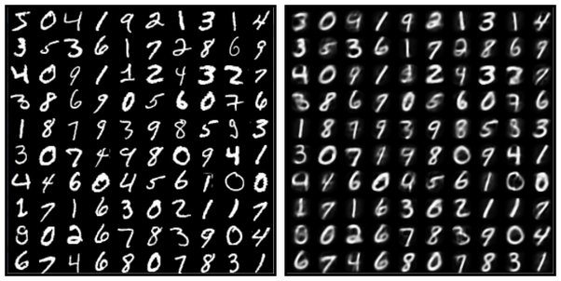
On the left some of our original input points, on the right what the autoencoder can reconstruct from the 25 dimensions in the middle layer. It's not perfect but it is pretty awesome isn't it?

Slide 5
So this shows that we can represent each MNIST digit as a vector in 25 dimensions, and this is where we can see the utility of an autoencoder, it is a feature extraction algorithm it helps us find a representation for our data and we can feed that representation to other algorithms, for example a classifier.
In some cases the features generated by the autoencoder represent the data points better than the points themselves, that's the key!

Slide 6
There are three main layers : encoder, code and decoder.
Encoder- This is the part of the network that compresses the input into a latent space representation. The encoder layer encodes the input image as a compressed representation in a reduced dimension. The compressed image typically looks garbled, nothing like the original image
Code- The next component represents the latent space. Code is the part of the network that represents the compressed input fed to the decoder.
Decoder- This layer decodes the encoded image back to the original dimension. The decoded image is a lossy reconstruction of the original image. It reconstructs the input from the latent space representation.

Slide 7
Application
Data Storage: The encoding processes are able to compress down large quantities of data, compressing it. This process, as you can imagine, has big benefits for data storage at scale.
Feature detection: The process used to encode the data identifies features of the data that can be used to identify it. This list of features is used in multiple systems to understand the data. (Convolutional Neural Networks also do feature detection in images)
Recommendation systems: One application of autoencoders is in recommendation systems. These are the systems that identify films or TV series you are likely to enjoy on your favorite streaming services.

Slide 8
Example in Keras
Lets Implementing an autoencoder for a numeric dataset .
Step 1: Import Libraries
import numpy as np
import pandas as pd
from sklearn.model_selection import train_test_split
from sklearn.preprocessing import StandardScaler
from tensorflow import keras
from tensorflow.keras import layers

Slide 9
Step 2: Load Your Dataset
Assuming you have a numeric dataset in a CSV file:
# Load the dataset
data = pd.read_csv('your_dataset.csv')
# Optionally, inspect the data
print(data.head())

Slide 10
Step 3: Preprocess the Data
Handle Missing Values: Fill or drop any missing values.
Scale the Data: Autoencoders work better with scaled data, so standardize or normalize your features.
# Fill missing values if necessary
data.fillna(data.mean(), inplace=True)
# Split the data into features and target if needed
X = data.values # Use all columns if no target variable
# X, y = data.drop('target_column', axis=1).values, data['target_column'].values
# Scale the data
scaler = StandardScaler()
X_scaled = scaler.fit_transform(X)
# Split into training and testing sets
X_train, X_test = train_test_split(X_scaled, test_size=0.2, random_state=42)

Slide 11
Step 4: Build the Autoencoder Model
Define the architecture for your autoencoder. The architecture can vary based on the complexity of your data.
# Define the autoencoder model
input_dim = X_train.shape[1] # Number of features
autoencoder = keras.Sequential([
layers.Input(shape=(input_dim,)),
layers.Dense(64, activation='relu'), # Encoder
layers.Dense(32, activation='relu'), # Bottleneck
layers.Dense(64, activation='relu'), # Decoder
layers.Dense(input_dim, activation='sigmoid') # Output layer
])

Slide 12
Step 5: Compile the Model
autoencoder.compile(optimizer='adam', loss='mean_squared_error')
Step 6: Train the Model
# Fit the model
history = autoencoder.fit(X_train, X_train,
epochs=50,
batch_size=256,
validation_data=(X_test, X_test))

Slide 13
Step 7: Evaluate the Model
You can use the model to reconstruct the input data and evaluate its performance.
# Get the reconstructed data
X_train_reconstructed = autoencoder.predict(X_train)
X_test_reconstructed = autoencoder.predict(X_test)
# You can calculate the reconstruction error
train_loss = np.mean(np.square(X_train - X_train_reconstructed), axis=1)
test_loss = np.mean(np.square(X_test - X_test_reconstructed), axis=1)
# Print some example losses
print("Train Loss: ", train_loss[:5])
print("Test Loss: ", test_loss[:5])

Slide 14
Step 8: Analyze the Results
You can visualize the reconstruction error to identify anomalies or evaluate the performance of your autoencoder.
import matplotlib.pyplot as plt
plt.hist(train_loss, bins=50, alpha=0.5, label='Train Loss')
plt.hist(test_loss, bins=50, alpha=0.5, label='Test Loss')
plt.legend()
plt.xlabel('Reconstruction Loss')
plt.ylabel('Frequency')
plt.title('Reconstruction Loss Distribution')
plt.show()

Slide 15
Exercise
Baseline Code
from sklearn.datasets import make_classification
from sklearn.preprocessing import MinMaxScaler
from sklearn.preprocessing import LabelEncoder
from sklearn.model_selection import train_test_split
from sklearn.linear_model import LogisticRegression
from sklearn.metrics import accuracy_score
from tensorflow.keras.models import load_model
from tensorflow.keras.models import Model
from tensorflow.keras.layers import Input
from tensorflow.keras.layers import Dense
from tensorflow.keras.layers import LeakyReLU
from tensorflow.keras.layers import BatchNormalization
from tensorflow.keras.utils import plot_model
import matplotlib.pyplot as plt

Slide 16
X, y = make_classification(n_samples=1000, n_features=100, n_informative=10, n_redundant=90, random_state=1)
X_train, X_test, y_train, y_test = train_test_split(X, y, test_size=0.33, random_state=1)
t = MinMaxScaler()
t.fit(X_train)
X_train = t.transform(X_train)
X_test = t.transform(X_test)
model = LogisticRegression()
model.fit(X_train, y_train)
y_pred = model.predict(X_test)
acc = accuracy_score(y_test, y_pred)
print(acc)

Slide 17
# load the model from file(autoencoder)
encoder = load_model('encoder.h5')
# encode the data
X_train_encode = encoder.predict(X_train) X_test_encode = encoder.predict(X_test)

Slide 18
model_encode = LogisticRegression()
# fit the model on the training set model_encode.fit(X_train_encode, y_train)
# make predictions on the test set
y_pred_encode=model_encode.predict(X_test_encode)
acc_encode = accuracy_score(y_test, y_pred_encode)
print(acc_encode)

Slide 19
print('Accuracy LogisticRegression Simple: {}'.format(acc))
print('Accuracy LogisticRegression With Autoencoder: {}'.format(acc_encode))

Slide 20
Autoencoder Design
X, y = make_classification(n_samples = 1000, n_features = 100, n_informative = 10, n_redundant=90, random_state = 1) print('Shape', X.shape)
X

Slide 21
n_inputs = X.shape[1] # Number of inputs
# Train test Split
X_train, X_test, y_train, y_test = train_test_split(X, y, test_size = 0.33, random_state = 1)

Slide 22
#Scale data
t = MinMaxScaler()
t.fit(X_train)
X_train = t.transform(X_train)
X_test = t.transform(X_test)

Slide 23
Encoder
In [ ]:
visible = Input(shape = (n_inputs,))
#Define Encoder #level 1
e = Dense(n_inputs*2)(visible) # e = encoder
e = BatchNormalization()(e)
e = LeakyReLU()(e)
# level 2
e = Dense(n_inputs)(e) e
= BatchNormalization()(e)
e = LeakyReLU()(e)
#Bottleneck
n_bottleneck = round(float(n_inputs)/2.0)
bottleneck = Dense(n_bottleneck)(e)
# Define Decoder #level 1
d = Dense(n_inputs)(bottleneck) # d = dencoder
d = BatchNormalization()(d)
d = LeakyReLU()(d)
#level 2
d = Dense(n_inputs*2)(d) # d = dencoder
d = BatchNormalization()(d)
d = LeakyReLU()(d)
#Output layer
output = Dense(n_inputs, activation = 'linear')(d)
#Define autoencoder model
model = Model(inputs = visible, outputs = output)
#compile autoencoder
model.compile(optimizer = 'adam', loss = 'mse')

Slide 24
plot_model(model, 'autoencoder_compress.png', show_shapes = True)
# Fit the autoencoder model to reconstruct input history = model.fit(X_train, X_train, epochs = 200, batch_size = 16, verbose = 2, validation_data = (X_test,X_test))
#Plot Loss
fig, ax = plt.subplots(figsize=(10,5))
plt.plot(history.history['loss'], label = 'train')
plt.plot(history.history['val_loss'], label = 'test')
plt.title('Autoencoder loss')
plt.xlabel('Epochs')
plt.ylabel('Loss')
plt.legend()
plt.savefig('Autoencoderloss.png')

Slide 25
#Define an encoder model without the decoder
encoder = Model(inputs =visible, outputs = bottleneck)
plot_model(model, 'encoder_compress.png', show_shapes = True)

Slide 26
# Save model
encoder.save('encoder.h5')

Slide 27
Q2. Load the built in data MNIST add some noise to images and then apply the autoencoder to denoise the dataset.

Slide 28
Adding noise
noise_factor = 0.5
X_train_noisy = X_train + noise_factor * np.random.normal(loc=0.0, scale=1.0, size=X_train.shape)
X_test_noisy = X_test + noise_factor * np.random.normal(loc=0.0, scale=1.0, size=X_test.shape) X_train_noisy = np.clip(X_train_noisy, 0., 1.)
X_test_noisy = np.clip(X_test_noisy, 0., 1.)

Slide 29
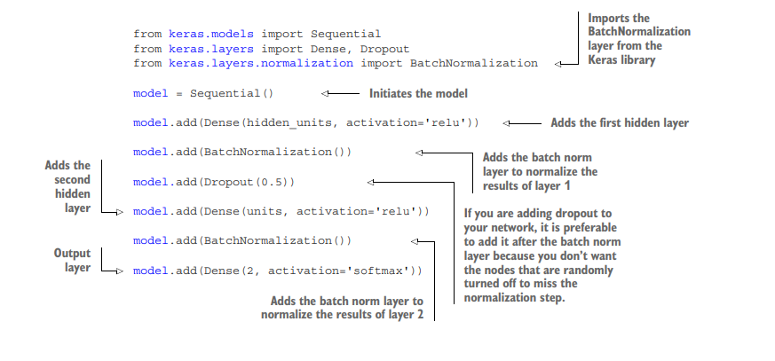
CNN

Slide 30
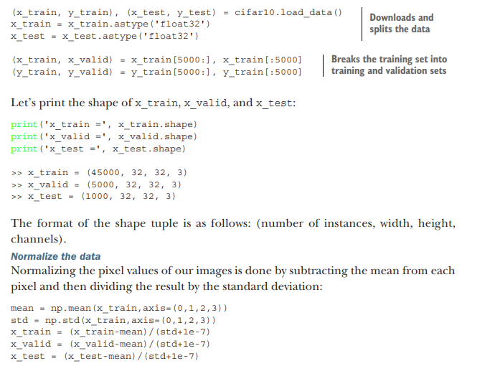

Slide 31
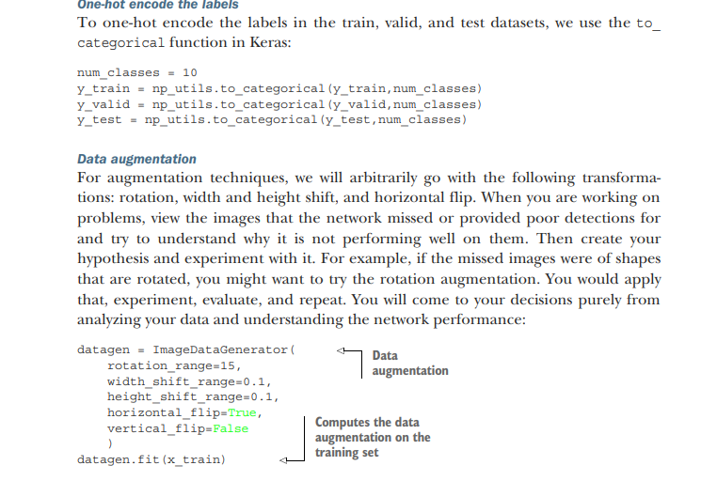

Slide 32
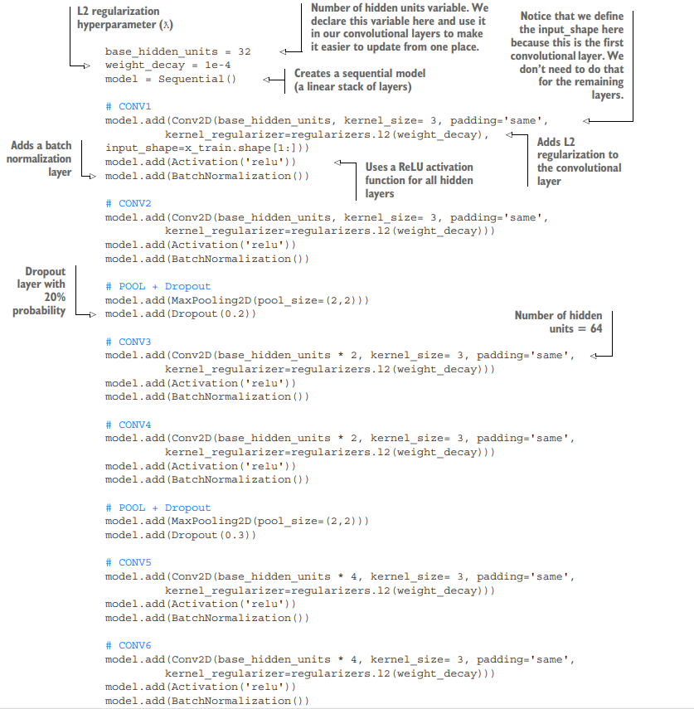

Slide 33
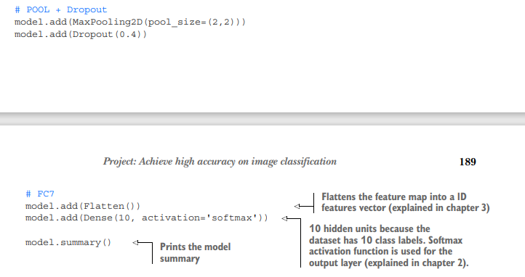

Slide 34
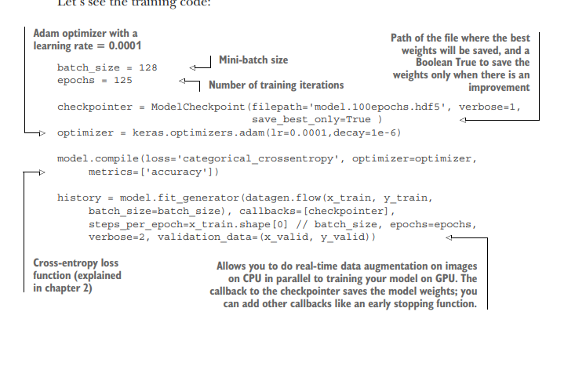

Slide 35
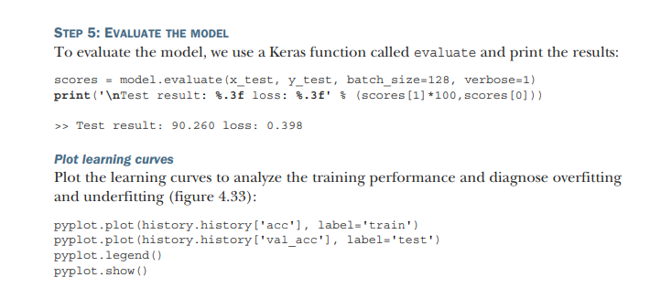

Slide 36
RNN
The next step in DL after having explored CNN is to start exploring RNN, popularly known as “sequence models.”
This name became popular because RNN makes use of sequential information.
So far, all the DNNs that we have explored process training data with the assumption that
there is no relationship between any two training samples.

Slide 37
Consider the predictive text feature in your iOS or Android phone; the prediction of the next word is highly dependent on the last few words you already typed.
That’s where the sequential model comes into the picture.

Slide 38
RNNs can also be understood as neural networks with memory.
It connects a layer to itself and thereby gets simultaneous access to two or more consecutive input samples to process the end output.
This property is unique to RNN, and with its rise in research, it delivered amazing success
in the field of natural language understanding.

Slide 39
All the legacy natural language processing techniques could now be significantly improved with RNNs.
The rise of chatbots, improved autocorrect in text messaging, suggested reply in e-mail clients and other apps, and machine translation (i.e., translating text from a source language to a target language, Google Translate being the classic example) have all been propelled with the adoption of RNN.

Slide 40
There are again different types of LSTM (long short-term memory) networks that overcome the limitations within the existing RNN architecture and take performance for natural language processing–related tasks a notch higher.
The most popular versions of RNN are LSTM and GRU (gated recurrent unit) networks.

Slide 41
from keras.datasets import imdb
from keras.models import Sequential
from keras.layers import Dense, LSTM
from keras.layers.embeddings import Embedding
from keras.preprocessing import sequence
#Setting a max cap for the number of distinct words
top_words = 5000
#Loading the training and test data from keras datasets
(x_train, y_train), (x_test, y_test) = imdb.load_data(num_
words=top_words)

Slide 42
#Since the length of each text will be varying
#We will pad the sequences (i.e. text) to get a uniform length throughout
max_text_length = 500
x_train = sequence.pad_sequences(x_train, maxlen=max_text_ length)
x_test = sequence.pad_sequences(x_test, maxlen=max_text_length)

Slide 43
#Design the network
embedding_length = 32
model = Sequential()
model.add(Embedding(top_words, embedding_length, input_length=max_text_length))
model.add(LSTM(100))
model.add(Dense(1, activation='sigmoid'))

Slide 44
#Compile the model
model.compile(loss='binary_crossentropy', optimizer='adam‘, metrics=['accuracy'])

Slide 45
#Fit the model
model.fit(x_train, y_train, validation_data=(x_test, y_test),epochs=3, batch_size=64)
scores = model.evaluate(x_test, y_test, verbose=0)
print("Accuracy:",scores[1])

Slide 46
VGG19 and VGG16
VGG is a simple network to understand because of the following reasons:
1.It uses only 3x3 convolution and 2x2 pooling throughout the network.
2.The convolutional layers use a very small kernel size (3x3).
3.There are 1x1 convolutions to linearly transform the input.
4.The stride is 1 pixel, and it helps to preserve the spatial resolution.
5.ReLU is used throughout all the hidden layers.
6.There are three Fully Connected layers with the _irst two layers having 4096 channels and the last one having 1000 channels. And finally we have a softmax layer.

Slide 48
Difference between VGG16 and VGG19
Generally, VGG16 is mostly used and is more popular.
It is due to the fact that in the general business world, we do not classify beyond eight to ten classes for a problem.
Moreover, getting a true representative and balanced data is not achieved. Hence, in practice, VGG16 is mostly used.

Slide 50
The CIFAR-10 dataset consists of 60000 32x32 color images in 10 classes, with 6000 images per class.
There are 50000 training images and 10000 test images. The dataset is divided into five training batches and one test batch, each with 10000 images. The test batch contains exactly 1000 randomly-selected images from each class.
The training batches contain the remaining images in random order, but some training batches may contain more images from one class than another. Between them, the training batches contain exactly 5000 images from each class.
The classes are completely mutually exclusive. There is no overlap between automobiles and trucks. “Automobile” includes sedans, SUVs, etc. and “Truck” includes only big trucks. Neither includes pickup trucks

Slide 51
import numpy as np
# Image manipulation | OpenCV
import cv2
# Showing images and evaluating model results
import matplotlib.pyplot as plt
# VGG19 Model
from keras.applications.vgg19 import VGG19
# Preparing VGG19 Model
from keras.layers import Dense,Flatten,Input
from keras.models import Sequential
# One hot label encoding
from keras.utils import to_categorical

Slide 52
# CIFAR10 dataset
from keras.datasets import cifar10
(x_train,y_train),(x_test,y_test) = cifar10.load_data()
print("Shape of x_train is ",x_train.shape)
print("Shape of y_train is ",y_train.shape)
print("Shape of x_test is ",x_test.shape)
print("Shape of y_test is",y_test.shape)
Shape of x_train is (50000, 32, 32, 3)
Shape of y_train is (50000, 1)
Shape of x_test is (10000, 32, 32, 3)Shape of y_test is (10000, 1)

Slide 53
def resize_img(img):
numberOfImage = img.shape[0]
new_array = np.zeros((numberOfImage, 48,48,3))
for i in range(numberOfImage):
new_array[i] = cv2.resize(img[i,:,:,:],(48,48))
return new_array

Slide 54
x_train = resize_img(x_train)
x_test = resize_img(x_test)
print("New shape of x_train is ",x_train.shape)
print("New shape of x_test is ",x_test.shape)
New shape of x_train is (50000, 48, 48, 3)
New shape of x_test is (10000, 48, 48, 3)
# one hot encoding
y_train = to_categorical(y_train,num_classes=10)
y_test = to_categorical(y_test,num_classes=10)

Slide 55
print("New shape of y_train is ",y_train.shape)
print("New shape of y_test is ",y_test.shape)
New shape of y_train is (50000, 10)
New shape of y_test is (10000, 10)

Slide 56
Include top = add fully connected layers to layer.# Weights = use pretrained weights (trained in imagenet)
vgg = VGG19(include_top=False, weights="imagenet",input_shape=(48,48,3))
vgg.summary()

Slide 57
model = Sequential()
# Adding layers to the blank model
for layer in vgg.layers:
model.add(layer)
# Don't train layers again, because they are already trained
for layer in model.layers:
layer.trainable = False

Slide 58
# Adding fully connected layers
model.add(Flatten())
model.add(Dense(128))
model.add(Dense(10,activation="softmax"))
# Checking model
model.summary()

Slide 59
# However before this, we need to compile the model
model.compile(optimizer="RMSprop",loss="categorical_crossentropy",metrics=["accuracy"]) # Let's train.
hist = model.fit(x_train,y_train,validation_split=0.15,epochs=20,batch_size=1000)

Slide 60
# We use %15 of the train set as validation set.
plt.subplots(figsize=(6,4))
plt.plot(hist.epoch,hist.history["loss"],color="green",label="Train Loss")
plt.plot(hist.epoch,hist.history["val_loss"],color="blue",label="Validation Loss")
plt.xlabel("Epoch Number")
plt.ylabel("Loss")plt.legend()plt.title("Loss Graph")
plt.show()

Slide 61
plt.subplots(figsize=(6,4))
plt.plot(hist.epoch,hist.history["accuracy"],color="green",label="Train Accuracy")
plt.plot(hist.epoch,hist.history["val_accuracy"],color="blue",label="Validation Accuracy")
plt.xlabel("Epoch Number")
plt.ylabel("Accuracy")
plt.legend()
plt.title("Accuracy Graph")
plt.show()
model.evaluate(x_test,y_test)

Slide 62
What is a Convolutional Neural Network?
When we humans see an image or a face, we are able to identify it immediately. It is one of the basic skills we have. This identification process is an amalgamation of a large number of small processes and coordination between various vital components of our visual system .
A Convolutional Neural Network or CNN is able to replicate this astounding capability using Deep Learning.
Consider this. We have to create a solution to distinguish between a cat and a dog. The attributes which make them different can be ears, whiskers, nose, and so on. CNNs are helpful for extracting the attributes of the images which are significant for the images. Or in other words, CNNs will extract the features which are distinguishing between a cat and a dog. CNNs are very powerful in image classification.

Slide 63
Imagine you have an image of size 32x32. That means it can be represented as 32x32x3 pixels if it is a colored image (remember RGB).
Now let us move (or convolute) an area of 5x5 over this image and cover the entire image. This process is called convolving. Starting from the top left, this area is passed over the entire image. You can refer to Figure 2-2 to see how an image 32x32 is being convoluted by a filter of 5x5.

Slide 64
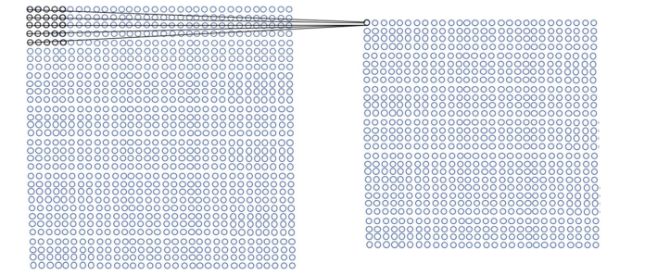

Slide 65
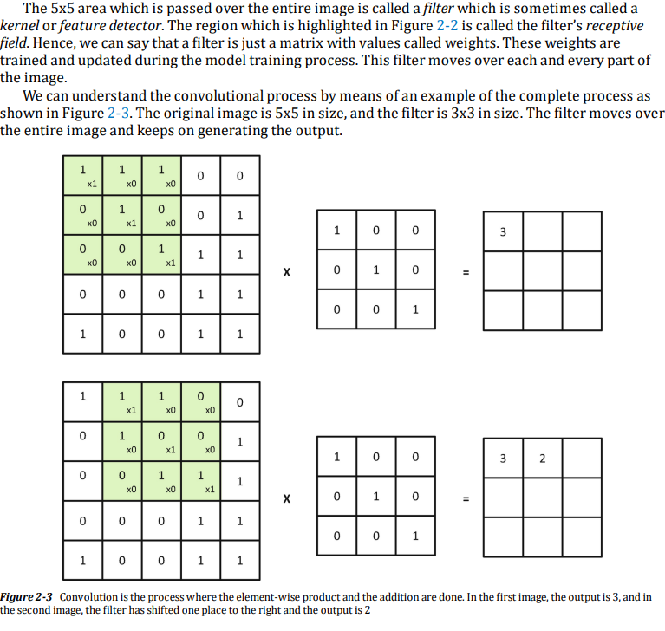

Slide 66
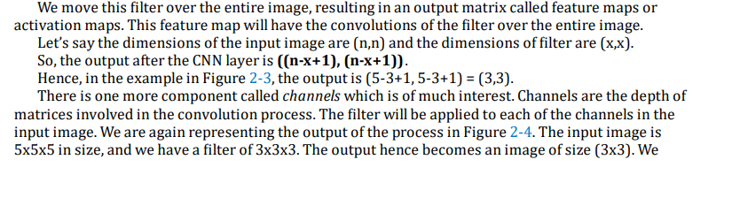

Slide 67
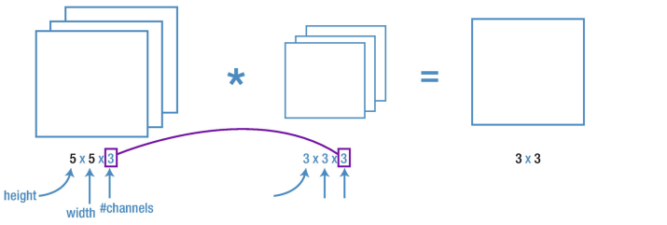

Slide 68
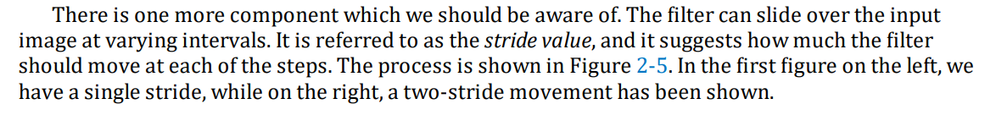

Slide 69
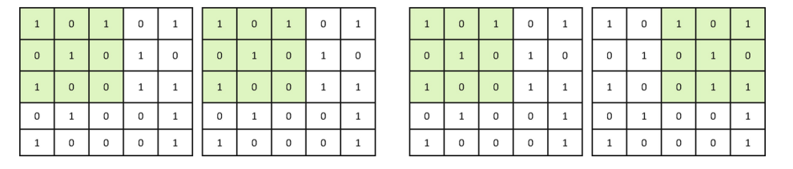

Slide 70
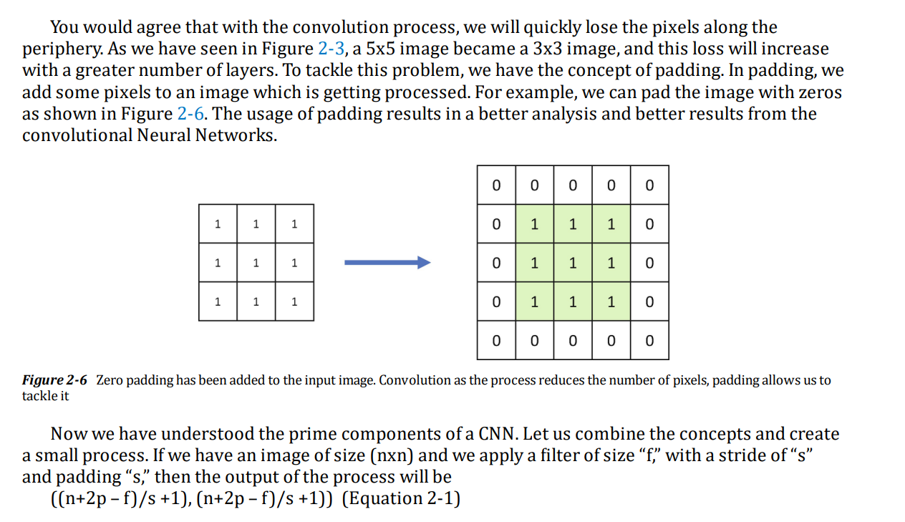

Slide 71
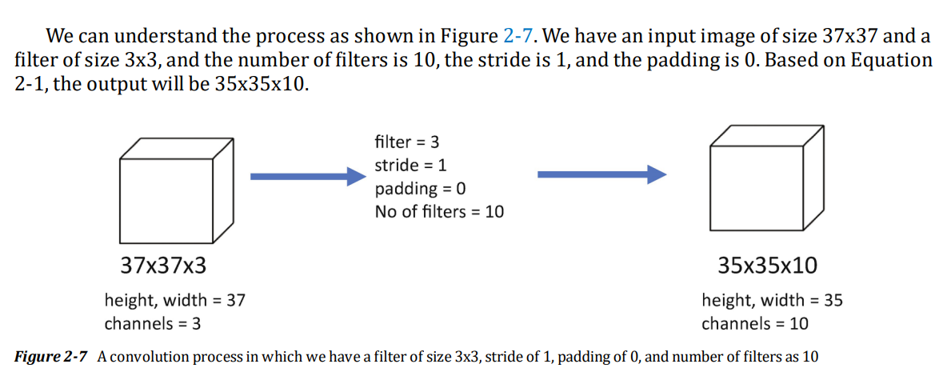

Slide 72
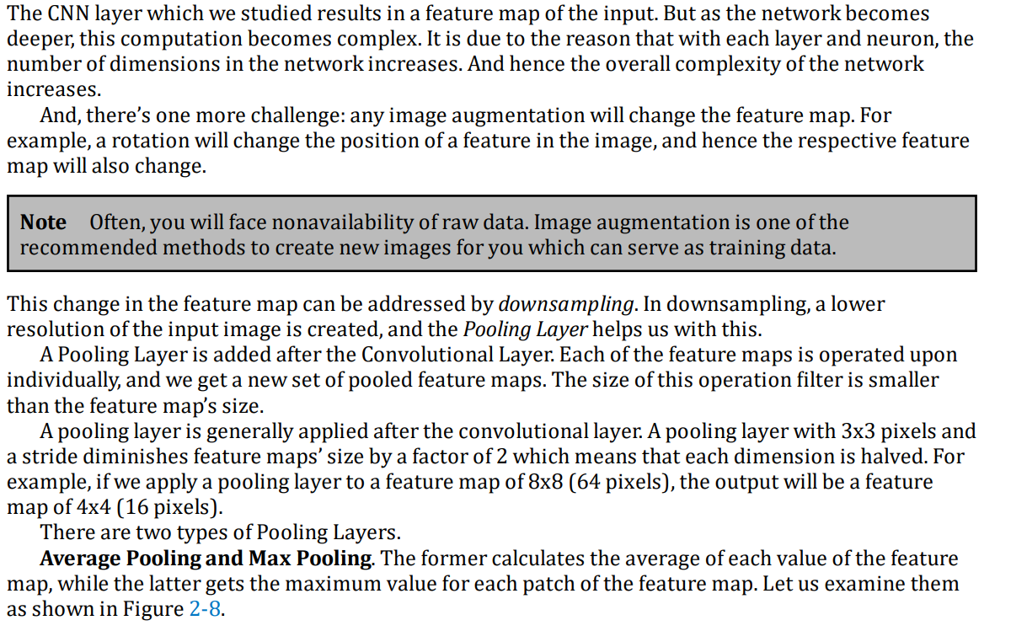
What is a Pooling Layer?

Slide 73
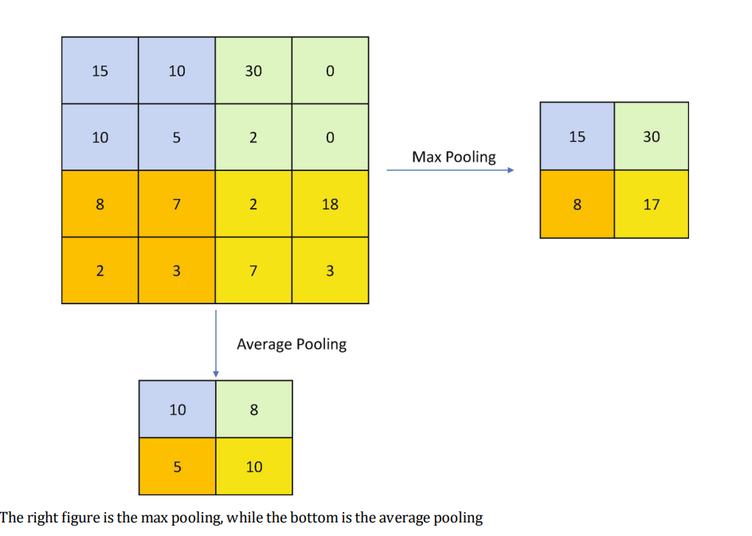

Slide 74
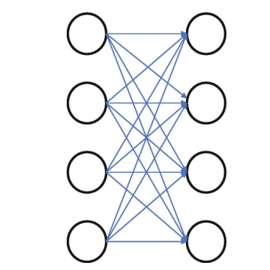
What is a Fully Connected Layer?

Slide 75
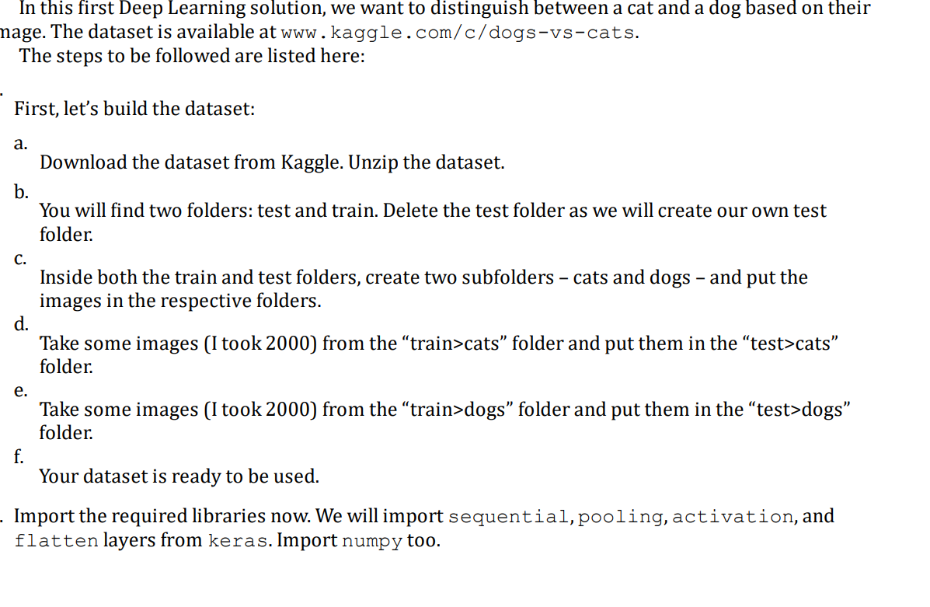

Slide 76
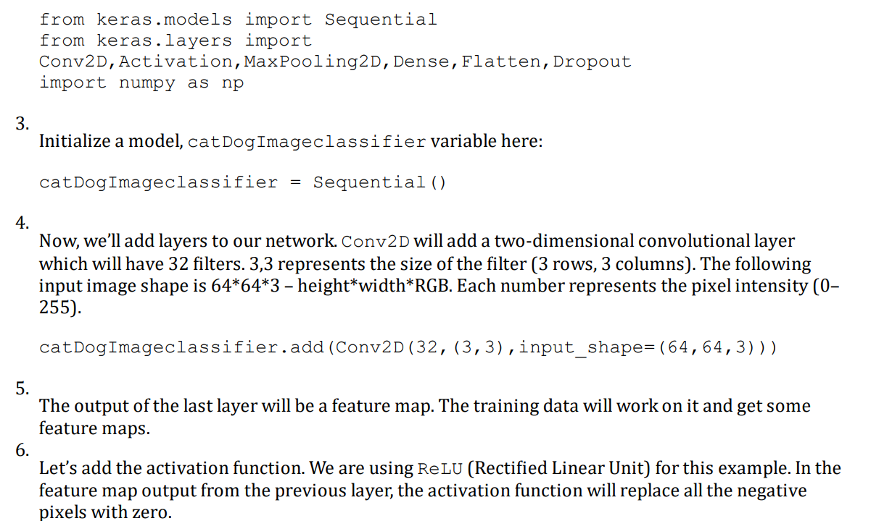

Slide 77
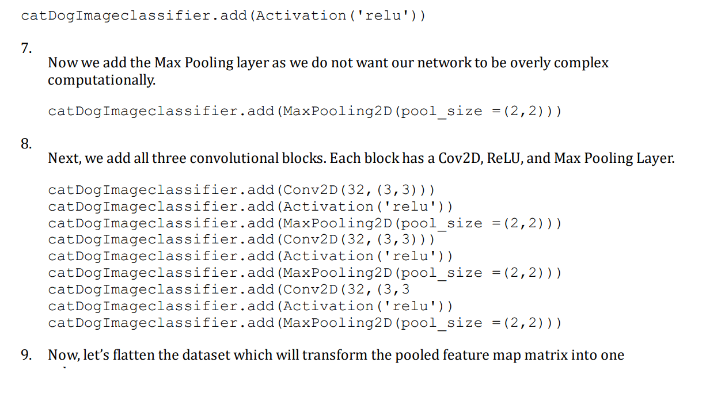

Slide 78
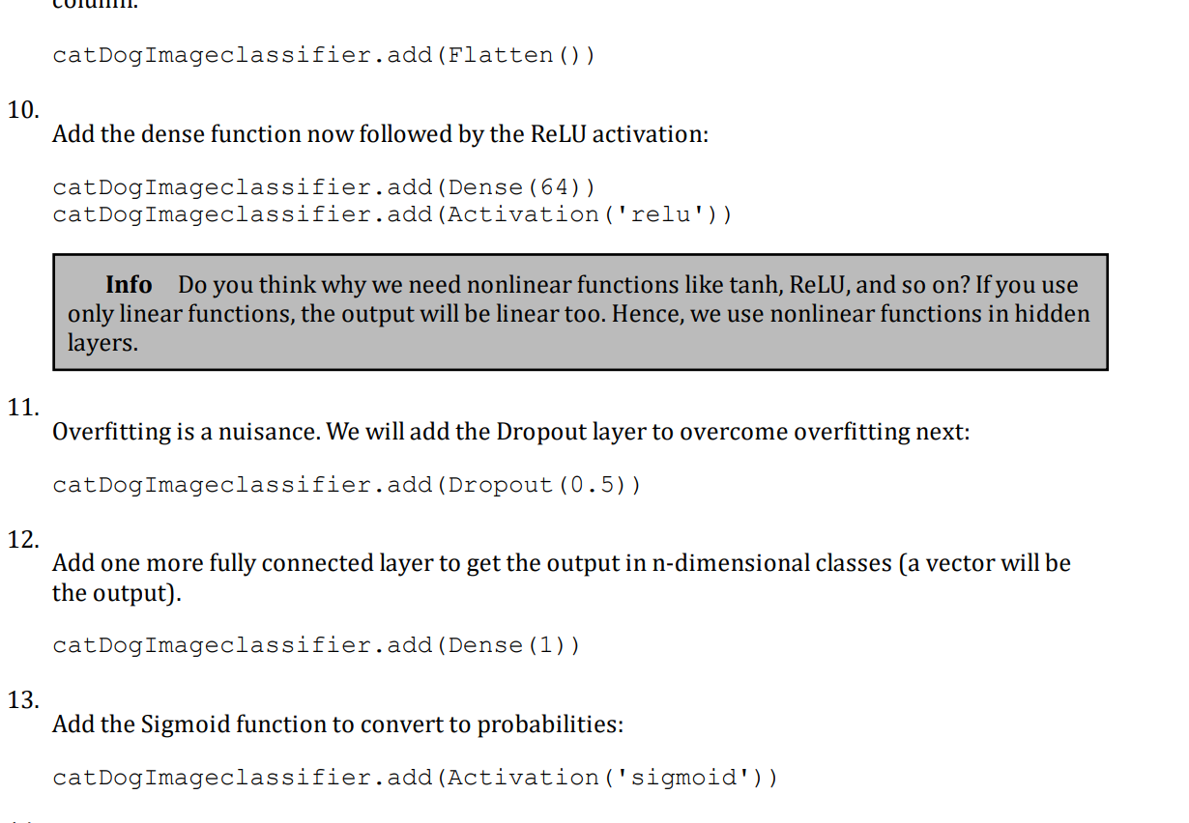

Slide 79
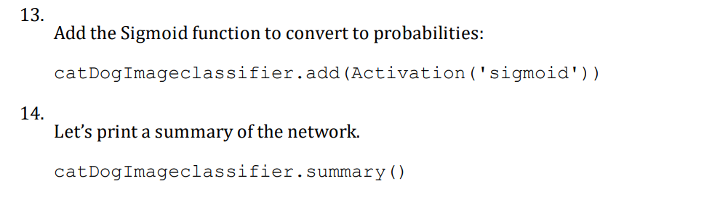

Slide 80
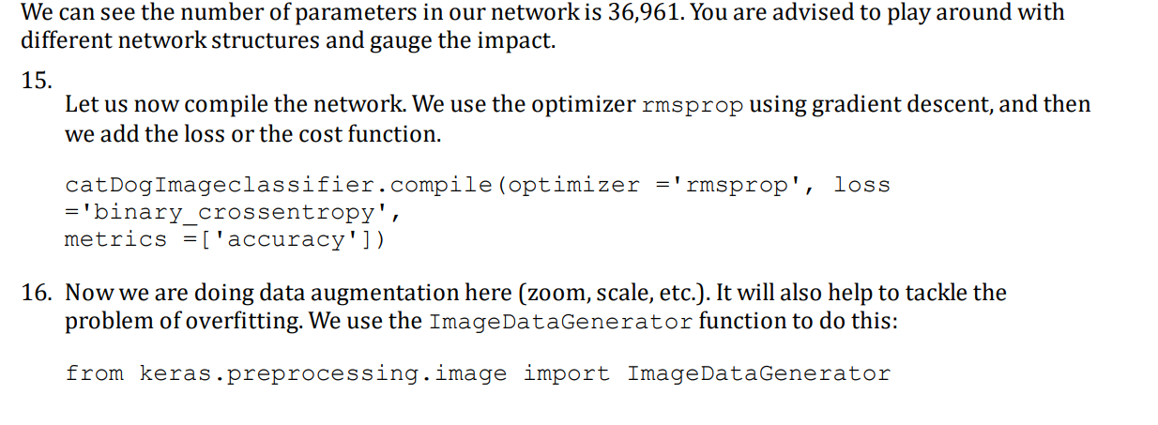
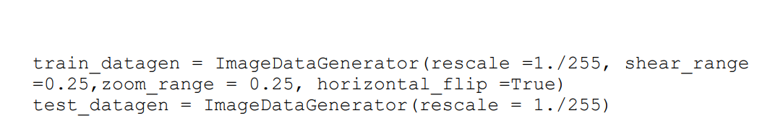

Slide 81
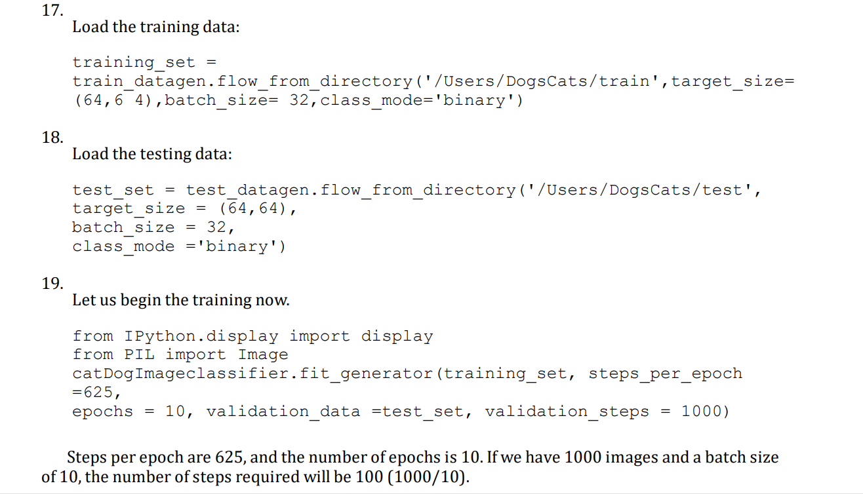

Slide 82
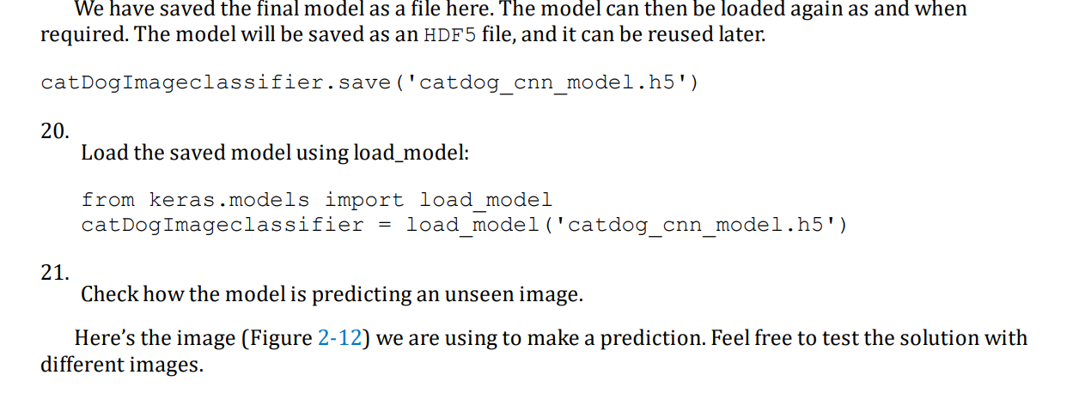

Slide 83
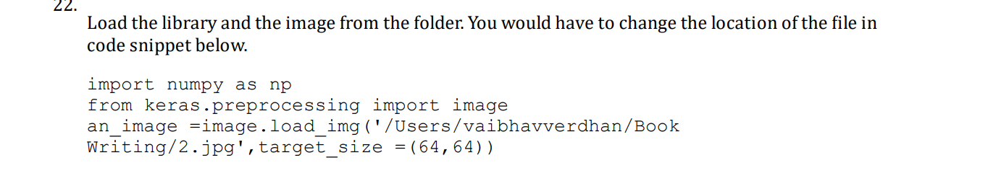

Slide 84
